Slide 1
Array
(Traversal, Search, Insertion, Deletion, Sorting)

Slide 2
Classification of Data Structures
Data Structure
Primitive
(All data-types available in the language)
Non-primitive
Linear
Non-linear
Array
Stack
Queue
Linked List
Trees
Graph

Slide 3
Memory Storage – One Dimensional Array
int student[4];
student[0]
student[2]
student[1]
student[3]
float
marks[3];
marks[0]
marks[2]
marks[1]

Slide 4
Memory Storage – Two Dimensional Array
int marks[3][5];
Can be visualized in the form of a matrix as
 | Col 0 | Col 1 | Col 2 | Col 3 | Col 4
Row 0 | marks[0][0] | marks[0][1] | marks[0][2] | marks[0][3] | marks[0][4]
Row 1 | marks[1][0] | marks[1][1] | marks[1][2] | marks[1][3] | marks[1][4]
Row 2 | marks[2][0] | marks[2][1] | marks[2][2] | marks[2][3] | marks[2][4]

Slide 5
Contd…
Row-major order
(0,0) | (0,1) | (0,2) | (0,3) | (0,4) | (1,0) | (1,1) | (1,2) | (1,3) | (1,4) | (2,0) | (2,1) | (2,2) | (2,3) | (2,4)
Row0
Row1
Row2
Column-major order
(0,0) | (1,0) | (2,0) | (0,1) | (1,1) | (2,1) | (0,2) | (1,2) | (2,2) | (0,3) | (1,3) | (2,3) | (0,4) | (1,4) | (2,4)
Co10
Col1
Col2
Col3
Col4

Slide 6
Array ADT
The simplest but useful data structure.
Assign single name to a homogeneous collection of instances of one abstract data type.
– All array elements are of same type, so that a pre−defined equal amount of memory is allocated to each one of them.
Individual elements in the collection have an associated index value that depends on array dimension.

Slide 7
Contd…
One-dimensional and two-dimensional arrays are commonly used.
Multi−dimensional arrays can also be defined.
Usage:
Used frequently to store relatively permanent collections of data.
Not suitable if the size of the structure or the data in the structure are constantly changing.

Slide 8
Operations on Linear Data Structures
Traversal
Search
Insertion
Deletion
Merging
Sorting

Slide 9
Traversal
Processing each element in the array.
Example: Find minimum element in the array
Algorithm arrayMinElement(A,n) Input: An array A containing n integers. Output: The minimum element in A.
cost time
c1 1 → c1
c2 n → c2 n
c3 c3 (n – 1)
∑^{t}i ^{c4}∑^{t}i
i=1 i=1
1 → c5
min = 0
for i = 1 to n-1 do
if A[min] > A[i]
n – 1 →
n−1
n−1
4.
min = i
c4
→
5. return A[min]
c5

Slide 10
Contd…
n−1
T(n) = c1 + c2 n + c3 (n – 1) + c4 ∑t_{i} + c5
i=1
n−1
= (c1 – c3 + c5) + (c2 + c3) n + c4∑t_{i}
i=1
Best case: Ω(n) → summation evaluates to 0.
Worst case: O(n) → summation evaluates to n.
Average case: θ(n) → summation evaluates to n/2.

Slide 11
Example – Traversal
//Determine smallest element in an array.
#include<iostream>
using namespace std;
int arrayMinElement(int arr[], int n) 5. {
int min = 0;
for (int i = 1; i < n; i++) 8. {
if (arr[i] < arr[min])
min = i;
11. }
12. return arr[min]; }

Slide 12
Contd…
13. int main()
14. {
15. int i, n, a[10];
cout << "Enter the array size (<=10): ";
cin >> n;
18. for (i = 0; i < n; i++)
{ cout << "Enter " << i+1 << " element: ";
cin >> a[i];
21. }
cout << "\nSmallest element is " << arrayMinElement(a,n);
return 0; }

Slide 13
Search
Find the location of the element with a given value.

Slide 14
Linear Search
Used if the array is unsorted.
Example:
Search 7 in the following array i 0 1 2 3 4 5 6
a[]
Found at index 6
10 | 5 | 1 | 6 | 2 | 9 | 7 | 8 | 3 | 4
Search 11 in the following array i 0 1 2 3 4 5 6 7
a[]
8 9 10
10 | 5 | 1 | 6 | 2 | 9 | 7 | 8 | 3 | 4
Not found

Slide 15
Contd…
Algorithm linearSearch(A,n,num)
Input: An array A containing n integers and number
num to be searched.
Output: Index of num if found, otherwise -1.
cost time
n n
∑^{t}i
i=0
→ c1 ∑t_{i}
i=0
n−1
for i = 0 to n-1 do c1
if A[i] == num c2
n−1
∑^{t}i → c2 ∑^{t}i
i=0 i=0
c3 1 → c3
c4 1 → c4
return i
return -1

Slide 16
Contd…
T(n) = c1 ∑t_{i}
i=0
+ c2 ∑t_{i}
i=0
n
n−1
+ (c3 + c4)
Best case: Ω(1) → summation evaluates to 1.
Worst case: O(n) → summation evaluates to n.
Average case: θ(n) → summation evaluates to n/2.

Slide 17
Example – Linear Search
#include<stdio.h>
int linearSearch(int a[], int n, int num)
{ for (int i = 0; i < n; i++)
if (a[i] == num) return i;
return -1; }
int main()
{ int i, n, a[10], num;
printf("Enter the size of an array (<=10): ");
9. for (i = 0; i < n; i++)
{ printf("Enter element at index %d: ",i);
printf("\nEnter number to search: ");
int found = linearSearch(a,n,num);
if(found != -1) printf("Element found at index %d",found);
else printf("Element not found.");
return 0;
}
scanf("%d",&n);
scanf("%d", &a[i]); } scanf("%d",&num);

Slide 18
Binary Searching
Used if the array is sorted.
Example:
Search 7 in the following array
i 0 1 2 3 4 5 6 7 8 9
a[]
 |  |  |  |  |  |  | 6 | 7
 | 1 | 2 | 3 | 4 | 5 |  |  |  |  | 8 | 9 | 10
1
index = (0+9)/2
2
index = (5+9)/2
3
4
Found at index 6
index = (5+6)/2
index = (6+6)/2

Slide 19
Contd…
Used if the array is sorted.
Example:
Search 11 in the following array
i 0 1 2 3 4 5 6 7 8 9
a[]
 |  |  |  |  |  |  |  |  |  |  |  | 9 | 10
 | 1 | 2 | 3 | 4 | 5 |  |  | 6 | 7 | 8
Not found
1
index = (0+9)/2
4
index = (9+9)/2
3
2
index = (8+9)/2
index = (5+9)/2

Slide 20
Contd…
Algorithm binarySearch(A,n,num)
Input: An array A containing n integers and number num to be searched.
Output: Index of num if found, otherwise -1.
beg = 0, end = n-1
while beg <= end do
mid = (beg + end)/2
if A[mid] == num
return mid
else if A[mid]>num
end=mid-1
else
beg=mid+1
return -1
.

Slide 21
Contd…
In each iteration, the number of elements to be searched from gets reduced by half. This process continues till the number of elements (to be searched) reaches to 1.
1st iteration – n/2⁰
2nd iteration – n/2¹
3rd iteration – n/2²
– …
m^{th} iteration – n/2^{m}
Let the termination condition (i.e. single element to search from) reaches at the m^{th} iteration, thus
2^{m} = n
mlog₂ 2 = log₂ n
m = lg n
⇒ complexity is O(lg n)
1 = ^{n}
₂m

Slide 22
Example – Binary Search
#include<stdio.h>
int binarySearch(int arr[], int n, int num)
{ int beg = 0, end = 9;
while (beg <= end)
{ int mid = (beg + end)/2;
if (arr[mid] == num)
return mid;
else if (arr[mid] > num)
end = mid - 1;
else if (arr[mid] < num)
beg = mid + 1;
12. }
13. return -1;
14. }

Slide 23
Contd…
int main()
{ int i, n, a[10], num;
printf("Enter the size of an array (<=10): ");
4. scanf("%d",&n);
5. for (i = 0; i < n; i++)
6. { printf("Enter element at index %d: ",i); 7. scanf("%d", &a[i]); }
printf("\nEnter number to search: ");
scanf("%d",&num);
int found = linearSearch(a,n,num);
if(found != -1)
printf("Element found at index %d",found);
else
printf("Element not found.");
return 0;

Slide 24
Insertion and Deletion
0 1 2 3 4 5 6 7 8 9
a[]
Insert 2 at index 1
8 | 6 | 3 | 4 | 5
4 3
2
1
0 1 2 3 4 5 6 7 8 9
a[]
2 6 3 4 5
Delete the value at index 2
1 2 3
0 1 2 3 4 5 6 7 8 9
a[]
8 | 6 | 3 | 4 | 5
8 | 1 | 6 | 3 | 4 | 5
3 4 5

Slide 25
Algorithm – Insertion
Algorithm insertElement(A,n,num,indx)
Input: An array A containing n integers and the number num to be inserted at index indx.
Output: Successful insertion of num at indx.
cost time
c1 n – indx + 1
c2 n – indx c3 1
c4 1
1. for i = n – 1 to indx do
2. A[i + 1] = A[i]
3. A[indx] = num 4. n = n + 1

Slide 26
Contd…
T(n) = c1 (n – indx + 1) + c2 (n – indx) + c3 + c4
Best case: | Ω(1) | → indx = n – 1
Worst case: | O(n) | → indx = 0
Average case: | θ(n) | → indx = n/2

Slide 27
Algorithm – Deletion
Algorithm deleteElement(A,n,indx)
Input: An array A containing n integers and the index
indx whose value is to be deleted.
Output: Deleted value stored initially at indx.
cost
c1
c2 c3 c4 c5
time
1
n – indx
n – indx – 1 1
1
temp = A[indx]
for i = indx to n – 2 do 3. A[i] = A[i + 1]
4. n = n – 1
5. return temp

Slide 28
Contd…
T(n) = c1 + c2 (n – indx) + c3 (n – indx – 1) + c4 + c5
Best case: | Ω(1) | → indx = n – 1
Worst case: | O(n) | → indx = 0
Average case: | θ(n) | → indx = n/2

Slide 29
Example – Insertion and Deletion
#include<stdio.h>
int n;
void insert(int a[], int num, int pos)
{ for(int i = n-1; i >= pos; i--)
a[pos] = num;
6. n++; }
int deleteElement(int a[], int pos)
{ int temp = a[pos];
for(int i = pos; i <= n-2; i++) 10. n--;
11. return temp; }
a[i+1] = a[i];
a[i] = a[i+1];
12. void printArray(int a[]) 13. { for (i = 0; i < n; i++) 14. printf("%d ",a[i]);

Slide 30
Contd…
int main()
{ int i, a[10], num, pos;
printf("Enter the size of an array (<10): ");
18. scanf("%d",&n); 19. for (i = 0; i < n; i++)
20. { printf("Enter element at index %d: ",i);
21. scanf("%d",&a[i]); }
printf("\nEnter number to be inserted: ");
scanf("%d",&num);
printf("Enter the desired index: ");
scanf("%d",&pos);
Insert(a,num,pos);

Slide 31
Contd…
printf("\nArray after insertion is...\n");
printArray(a);
printf("\nEnter the index whose value is to be deleted: ");
scanf("%d",&pos);
printf("\nThe deleted element is %d.", deleteElement(a,pos));
printf("\nArray after deletion is...\n");
printArray(a);
return 0;
35. }

Slide 32
Sorting
Rearranging elements of an array in some order.
Various types of sorting are
Bubble Sort.
Insertion Sort.
Selection Sort.
Quick Sort.
Merge Sort.
Heap Sort.

Slide 33
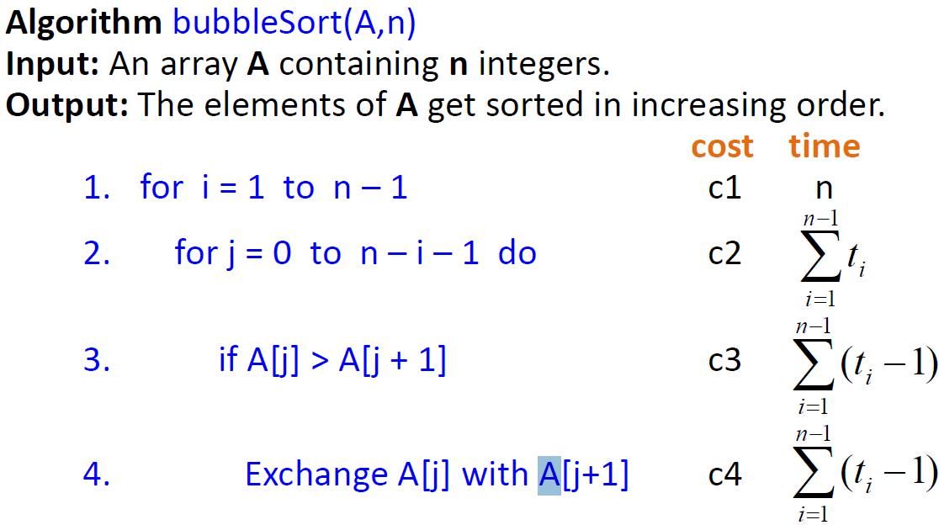
Algorithm – Bubble Sort

Slide 34
Algorithm – Optimized Bubble Sort
Algorithm bubbleSortOpt(A,n)
Input: An array A containing n integers.
Output: The elements of A get sorted in increasing order.
for i = 1 to n – 1
flag = true
for j = 0 to n – i – 1 do 4. if A[j] > A[j + 1]
5. flag = false
6.
if flag == true
break;
The best case complexity reduces to the order of n, but the worst and
average is still n².
Exchange A[j] with A[j+1] _{So, overall the}
complexity is of the order of n² again.

Slide 35
Example – Bubble Sort
#include<stdio.h>
void bubbleSortOpt(int a[],int n);
int main() 4. {
5. int a[10];
6. printf("Enter 10 numbers: \n"); 7. for(int i = 0; i < 10; i++)
8. scanf("%d",&a[i]);
bubbleSortOpt(a,10);
printf("\n");
11. for(int i = 0; i < 10; i++)
printf("%d ",a[i]);
return 0;
}

Slide 36
Example – Bubble Sort
void bubbleSortOpt(int a[], int n)
{ int i, j, flag;
17. for (i = 1; i <= n-1; i++) 18.
19.
20.
21.
22.
23.
24.
25.
26.
27.
{ flag = 1;
for (j = 0; j <= n-1-i; j++)
{ if (a[j] > a[j+1])
{ flag = 0;
a[j] = a[j] + a[j+1];
a[j+1] = a[j] - a[j+1];
a[j] = a[j] - a[j+1];
}
}
if(flag) break;
28. }
}

Slide 37
String definition
String is a 1-d array of characters terminated by a null (‘\0’ )
char C[] = {'A','B','C','\0'};
char S[] = "ABC";
Both C and S have length = 3

Slide 38
String input including blanks
main(){
char name[25] ;
printf ( "Enter name: " ) ;
scanf ( "%[^\n]s", name ) ;
printf("hello %s",name);
}

Slide 39
Another way
main(){
char C[20];
gets(C); // accepts blank spaces
puts(C);
}

Slide 40
NULL and strlen()
main(){
int i=0;
char C[10];
gets(C);
while(C[i]!=NULL) printf("%c",C[i++]);
//OR while(i<strlen(C)) printf("%c",C[i++]);
}

Slide 41
Few Inbuilt functions
main( ) {
char A[] = "wxYZ", B[]="78",C[20];
printf("length of %s = %d",A,strlen(A));
if(strcmp(A,B)==0) printf("\nA,B same srings");
printf("\nC = %s",strcpy(C,A));
printf("\nUppercase of A = %s",strupr(A));
printf("\nConcat A+C = %s",strcat(C,A));
printf("\n Reverse A = %s",strrev(A));
}

Slide 42
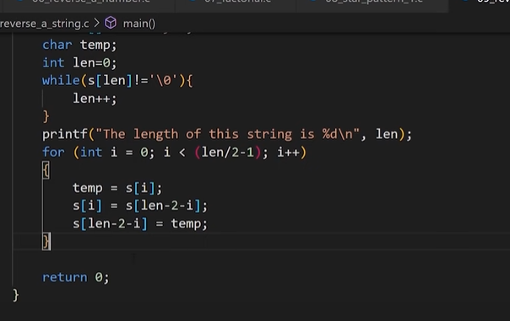
Reverse of string without strrev()
int main() {
char str[10], temp;
int i=0, j = 0;
printf("\nEnter the string :");
gets(str);
while(str[i]!=NULL)//String Length
{ i++; j++; }
j=j-1;i=0;
while (i < j) { //String Reverse
temp = str[i];
str[i] = str[j];
str[j] = temp;
i++; j--;
}
printf("\nReverse string is :%s", str);
return (0);
}

Slide 43
2-d character array
char Names[6][10] = {"akshay","parag","raman"};
puts(Names[0]); //akshay

Slide 44
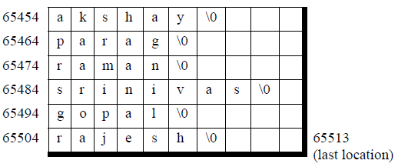
char Names[6][10] storage

